Slide 1
Auditing and Accounting
Jahid Hasan
Assistant Professor
Dept. of IPE,SUST

Slide 2
What Is An Audit?
Audit refers to any independent examination, any objective assessment of something.

Slide 3
What Is An Audit?
In public administration audit refers to either of two very common activities.
  The official examination of a financial report submitted by an individual or organization to determine whether it accurately represents expenditures, deductions, or other allowances determined by laws or regulations; Or.
  The final phase of the government budgetary process, which reviews the operations of an agency, especially its financial transactions, to determine whether the agency has spent its money in accordance with the law, in the most efficient manner, and with desired results.

Slide 4
What Is An Audit?
In all cases, an audit connotes comparison with some standard.
The essence of auditing is measuring something against a good example to make a critical, an evaluative, judgment.
Virtually all modern organizations from a local tennis club to the U.S. Government have auditors whose basic task is to certify that the financial accounts of the organization are correct.

Slide 5
What Is An Audit?
Auditing has become a major branch of the accounting profession, with complex professional standards and procedures for admission, practice, and reporting.
The audit of large corporations and agencies is supposed to certify that they comply both with the law and with national accounting standards.

Slide 6
Multiple Applications
Management audit.
  An independent examination of the policies, practices, and performance of management functions within an organization.

Slide 7
Multiple Applications
Performance audit.
  An independent examination of the policies, practice, and performance of an organization to determine if the desired results or benefits established by the legislature or other authorizing body are being achieved.
Efficiency audit.
  An independent examination of the policies, practices, and performance of an organization to determine if the organization manages and uses its resources so as to achieve the maximum benefit at the minimum cost.

Slide 8
Multiple Applications
Other applications.
  Environmental audit to assess compliance with environmental laws and sound environmental practices.
  Energy audit to assess the use or waste of energy.
  Water or telecommunications audits to reduce utility bills.
  Social audit to assess social issues in an organizational context.

Slide 9
Multiple Applications
Audit processes focus on the present and the immediate past.
Future audits are usually called impact statements or assessments.
Audits can be conducted internally or externally.
  Internal audits (conducted by a unit independent of management) designed to provide objective advice quickly.
  External audits comes from outside, but also usually reports outside.

Slide 10
History of Auditing
Modern audit developed in the nineteenth century when the growth of public sector activities became so complex that an independent and objective assessment of financial management became essential.
With huge sums of money moving around global empires, the temptation to corruption was overwhelming.

Slide 11
History of Auditing
Great Britain created its Office of Comptroller-General in 1857.
The U.S. General Accounting Office (Government Accountability Office in 2004) was established in 1921.
The establishment of independent auditing offices helps the audit function stand above corruption and apart from the political administration of the day.

Slide 12
History of Auditing
The prestige and renown of the individual in charge of an audit office can be important in personifying the integrity and credibility of the office.

Slide 13
AUDIT – PROCEDURE
1. VERIFICATION OF ANNUAL ACCOUNT + CLASSIFICATION REGISTERS
2. CASH BOOK + BANK PASS BOOK/ challans/cheques + grant files/ receipt books/ all records of moneys received/paid
3. SALARY BILLS +advances registers
4. TA/LTC/TTA BILLS + advances register
5. CONTINGENT BILLS + STOCK REGISTERS (telephones/stationery/equipment, vehicle log books etc.
6. WORKS BILLS + M.books/estimates/tender files,etc

Slide 14
Summary of the Audit Process - Phase I (Planning)
Accept client and perform initial planning.
Understand the client’s business and industry.
Assess client’s business risk.
Perform preliminary analytical procedures.
Set materiality and assess acceptable audit risk
and inherent risk.
Understand internal control and assess control risk.
Develop overall audit plan and audit program.

Slide 15
Summary of the Audit Process - Phase II (Begin Field Work)
From
Phase I
Plan to reduce assessed
level of control risk?
No
Yes
Perform tests of controls.
Perform substantive tests of transactions.
Assess likelihood of misstatements in
financial statements.

Slide 16
Summary of the Audit Process Phase III (End of Fieldwork)
From
Phase II
Likelihood of Misstatement
in Financial Statements
Low Medium High or
unknown
Perform analytical procedures.
Perform tests of key items.
Perform additional tests of details of balances.

Slide 17
Summary of the Audit Process Phase IV (Wrap-Up)
From
Phase III
Review for contingent liabilities.
Review for subsequent events.
Accumulate final evidence.
Evaluate results.
Issue audit report.
Communicate with audit
committee and management.

Slide 18
TYPES OF OBJECTIONS
1. RECOVERY NATURE
2. RECTIFICATION
3. ACTION ORIENTED
4. NON-PRODUCTION
5. SERIOUS IRREGULARITIES misappropriation, etc
6. UTILISATION OF FUNDS – excess/under/non/mis
7. NON-FURNISHING OF - accounts/reconciliation statements/u.cs/bank statements/challans/cheques
8. OTHERS

Slide 19
CATEGORIES OF AUDIT OBJECTIONS
01. VARIATION IN ACCOUNT FIGURES 02. FUNDS DIVERSTION/DIVERSION OF GRANTS
03. NON-COLLECTION OF DUES
04. NON-UTILISATION OF ALLOCATED AMOUNTS
05. MIS-UTILISATION
06. MISAPPROPRIATIONS
07.ADVANCES PENDING ADJUSTMENT
08. UN-UTILISATION / UNDER-UTILISATION ( i.e. unspent amounts)
09. EXCESS UTILISATION
10. IRREGULAR & WASTEFUL EXPENDITURE
11. OFFICE MANAGEMENT RESULTING IN SHORT REALISATION
12. EXCESS & INADMISSIBLE PAYMENTS

Slide 20
CATEGORIES OF AUDIT OBJECTIONS
13. INSTANCES OF CASES UN-ACCOUNTED FOR (shortage of stores/cash)
14. PURCHASES – NON-OBSERVANCE OF RULES
15. FAILURE TO DISCHARGE CERTAIN OBLIGATIONS UNDER THE RULES
16. PROMOTION / APPOINTMENTS CONTRARY TO RULES AND WITHOUT OBSERVING QUALIF
ICATION NORMS
17. PROCEEDURAL LAPSES
18. RECORDS -- non-maintenance /non-production
19. OTHERS -- i) NO.OF POSTS sanctioned / utilised / variation

Slide 21
For speedy settlement of audit objections
1. GROUPING
2. INITIATION OF ACTION
3. RECOVERY
4. MAINTAINING RECORDS
5. PRODUCTION OF FILES, etc
6. RENDERING – accounts/remittance challans/ cheques/bank reconciliation statement/bank statements/u.cs /acquittances, etc.
7. FURNISHING OF REPLIES EXPEDITIOUSLY

Slide 22
Types of Audit
The GAO in its Standards for Audit of Governmental Organizations, Programs, Activities, and Functions maintains that a comprehensive audit program should include the following three types of audit:

Slide 23
AUDIT TYPES
1. INTERNAL AUDIT
2. PRE-AUDIT
3. POST AUDIT
4. CONCURRENT AUDIT
5. SPECIAL AUDIT
6. EXTERNAL AUDIT

Slide 24
OTHER TYPES:
• SOCIAL AUDIT
• ENERGY AUDIT
• QUALITY AUDIT
• MANAGERIAL STYLE AUDIT
• SECRETARIAL AUDIT
• HUMAN RESOURCES AUDIT
• ENVIRONMENTAL AUDIT
• MARKETING AUDIT, ETC

Slide 25
Types of Audit
Financial and compliance:
  Whether the financial statements of an audited entity present fairly the financial position and the results of financial operations in accordance with generally accepted accounting principles.
  Whether the entity has complied with laws and regulations that may have a material effect upon the financial statements.

Slide 26
Types of Audit
Economy and efficiency:
  Whether the entity is managing and utilizing its resources (such as personnel, property, and space) economically and efficiently;
  The causes of inefficiencies and uneconomical practices; and.
  Whether the entity has complied with laws and regulations concerning matters of economy and efficiency.

Slide 27
Types of Audit
Program results:
  Whether the desired results or benefits established by the legislature or other authorizing body are being achieved; and
  Whether the agency has considered alternatives that might yield desired results at a lower cost.

Slide 28
Compliance Audit
The oldest and most traditional form of auditing activity is known as compliance audit.
The auditor is looking for the extent to which, in the financial management of the organization, financial inputs have been managed in compliance with the law and accepted standards and conventions for the treatment of accounting information.

Slide 29
Compliance Audit
The value of this form of audit is clear.
Officials dealing with funds cannot simply dispose of them as they see fit.
The advent of traditional auditing meant that every public official had to expect and prepare for a regular visit by the auditor, had to keep records in the prescribed format, and had to make records available to the auditor.

Slide 30
Compliance Audit
However, voluntary compliance is the basis of a civil society.
  IRS and tax payment.
Compliance auditing is also undertaken by funding agencies to judge whether a grantee is acting in accordance with the granter’s policies or preset guidelines.

Slide 31
Compliance Audit
Compliance auditing is inherently limited because it focuses on inputs or resources, rather than outputs or results.
Complying with the law is not the same as achieving results.
As a result, most audit offices began to turn to performance auditing.

Slide 32
Performance Audit
Performance auditing is an independent auditing process aimed at evaluating the measures instituted by management or the lack of these measures to ensure that:
❑ Resources have been acquired economically; and
Utilised efficiently and effectively

Slide 33
Performance Audit
Performance audit has two steps:
  Efficiency audit.
  Effectiveness audit.
  Often combined into comprehensive audit.
An efficiency audit compares the activities of the organization with the objects that have been assigned to it.
  Compliance audit but focused on extent of achievement of objectives.

Slide 34
Why is it important?
Based on need for public accountability
  Insight into activities of public agency on behalf of stakeholders
Reliable independent information on performance strengthens legitimacy and trust
Basis for future decisions
Incentives for change
Better government spending, better services, better public accountability and better public management
Are things done in the right way; are the right things being done?

Slide 35
Performance Audit
When the scope of audit expands to effectiveness audits, you shift from the extent to which preset objectives are achieved to whether those objectives were right in the first place.
Effectiveness audits are inherently political and must be dressed in apolitical clothes.
Methodologically neutral as a matter of science and politically neutral as a matter of strategy.
Nevertheless, often not independent enough to escape political retribution or compromise.

Slide 36
Performance audit process
Monitoring of the administration
Audit proposals
Audit plan (by the Auditor General)
Preliminary study *
Full study (audit work)
Draft report & feedback from the auditee*
Audit report *
Press release
Follow-up study

Slide 37
Audit process
Decision on
starting
the audit
Decision on
further
measures
Decision on
further
measures
Preliminary
study
Audit
Initial
meeting
Prel.study
meeting
Final
meeting
DG, AD
AM I / II
A
DG, AD
AM I / II
A
DG, AD
AM I / II
A
A
AM I
A
AM II, AD

Slide 38
Internal Audit
Managers are often reluctant to wait for an external examination to find problems in their organization.
Many government agencies have internal audit agencies.
To work, they need to have:
  Reporting authority high in the organization.
  Adequate, clear authority, support and resources, and the right to enter all parts of the organization.

Slide 39
Internal Audit
Internal audit functions vary:
  Compliance audit.
  Independent troubleshooters.
Internal auditors with freedom to determine their own agendas are inspectors general.

Slide 40
Internal Audit
To ensure independence:
  Location outside line management.
  A high reporting line for audit results.
  Reasonable latitude in selecting assignments.
Small agencies have a problem of resources, so more external audits done.

Slide 41
Accounting
An important issue underlying any successful traditional or comprehensive audit process is the nature and quality of the underlying financial and performance information kept by the organization.
The development of accounting principles and practices that lay down procedures for gathering and keeping data in meaningful ways is an absolutely essential foundation for effective management and the audit of it.

Slide 42
Accounting
Private sector accounting standards set by the Financial Accounting Standards Board.
Public sector accounting standards set by the Federal Accounting Standards Advisory Board.

Slide 43
Accounting
Cash accounting.
  Traditional method of accounting simply sought to control and track the passage of cash funds voted by legislatures as the funds were allocated to and spent by agencies.
  Too simplistic for complex government operations.

Slide 44
Accounting
Accrual accounting.
  Prompted a shift to accrual accounting.
  Allows for true measures of income and expenditures whether or not cash payments associated with the earnings or debts have actually taken place.
  Can only calculate a balance sheet if you use accrual accounting. Requires the determination of assets and liabilities.
  Fixed assets must be capitalized and depreciated. Accrued liabilities must be accounted for.

Slide 45
Accounting
Modified accrual accounting.
  Many governments in the United States used modified accrual accounting, which matches revenues raised and costs incurred, but may ignore long-term liabilities and the adequate valuation of assets.
  Leaves room for political manipulation.

Slide 46
Asset Management
The conceptual move to accrual accounting has had immense impact.
Under cash accounting, government did not have to identify capital or assets.
Under accrual accounting, they must systematically program the maintenance of assets throughout their life cycles, to value assets, to look for returns from them, or to have asset disposal programs.

Slide 47
Asset Management
In the public sector, some assets are commercial (railroads, utilities, airlines). These must use commercial standards of asset management.
Most government also own assets of intrinsic worth.
Governments have to establish criteria to determine which assets may be sold in a financial crunch and which cannot be sold because of intrinsic value.
Difficult to sell public assets.

Slide 48
Responsibility of Auditor
  Independence
  Ensure leadership visibility throughout the audit
  Determine if financial statements are free from material misstatement
  Do test checks on amounts and disclosures in financial statements
  Consider internal control
  Evaluate accounting policies
  Evaluate presentation of financial statements
  Evaluate non-compliance
  Evaluate controls regarding performance information
  Provide reports that ensure simplicity and clarity of audit messages

Slide 49
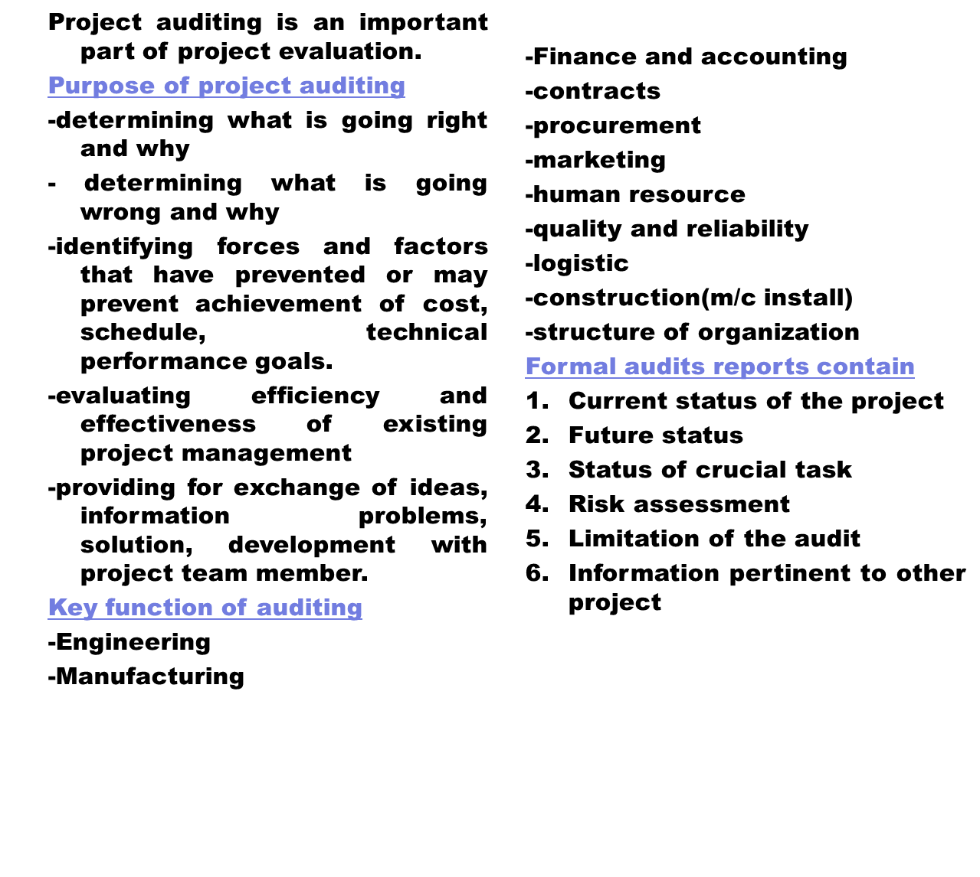
    Project Auditing/Audits

Slide 50
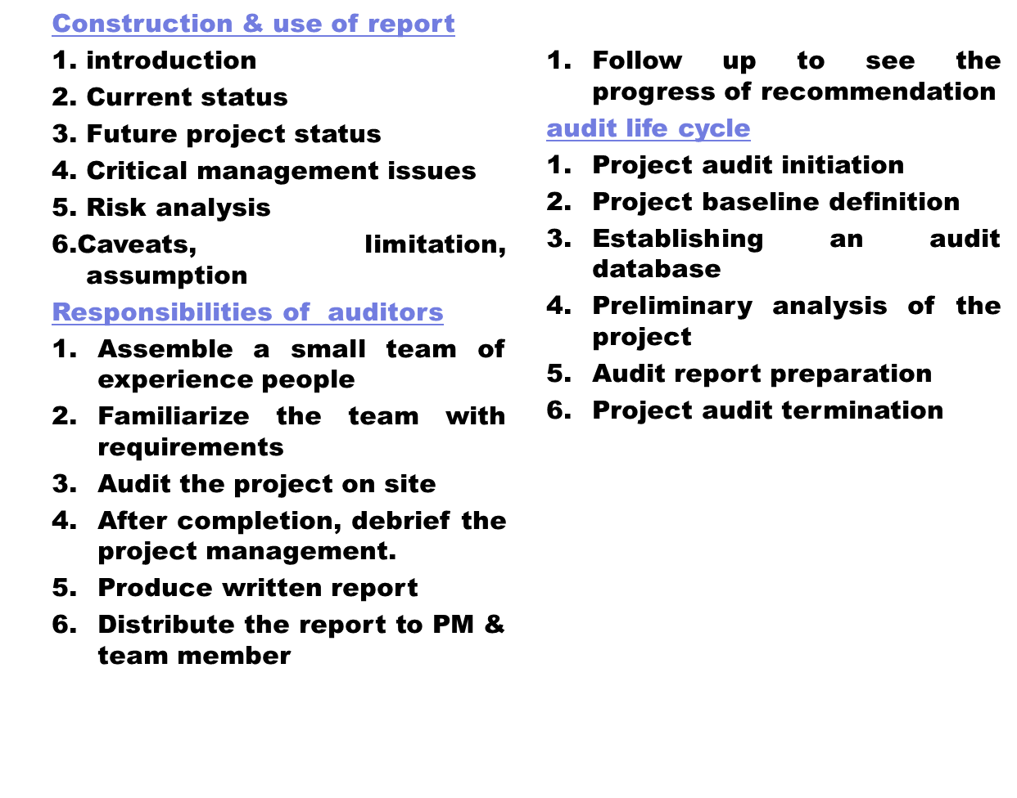
    Auditing/Audits

Slide 51
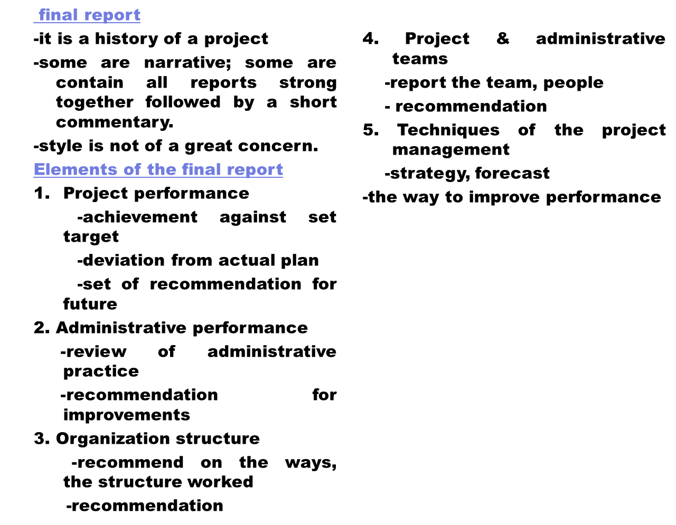
    Final Report

